Slide 1
SOFTWARE TESTING
CH01: Fundamentals of Software Testing
Course Instructor: AMIR IMAM

Slide 2
Content
What is Testing?
Why is Testing Necessary?
Quality vs Testing
Testing General Vocabulary
Testing Objectives
General Testing Principles
Test Process

Slide 3
What is TESTING?
Most people have an experience with software that did not work as expected. Software that does not work correctly can lead to many problems, including:
Loss of Money
Time
Business Reputation
Injury or Death
“Software testing is a way to assess the quality of the software and to reduce the risk of software failure in operation.”

Slide 4
What is TESTING?
1979: Software testing is a process of executing a program or application with the intent of finding the errors.
1983: Testing is an activity that measures the Software Quality.
2002: Testing is a concurrent lifecycle process of engineering, using and maintaining testware in order to measure and improve quality of software being tested.

Slide 5
What is TESTING?
Modern Definition:
The process of verifying and validating that a software program, application or product:
Meets the business and technical requirements.
Works as expected.

Slide 6
Why is Testing Necessary?
Software Testing is necessary because we all make mistakes. Some of those mistakes are unimportant, but some of them are expensive and dangerous.
“We need to check everything and anything we produce because things can always go wrong – humans make mistakes all the time.”

Slide 7
Quality VS Testing
“Quality software is reasonably bug or defect free, delivered on time and within budget, meets requirements and expectations, and is maintainable.”
ISO Definition of Quality :
ISO 8402-1986 standard defines quality as:
“the totality of features and characteristics of a product or service that bears its ability to satisfy stated or implied needs.”

Slide 8


Cognition in Testing

Slide 9
Cognition in Testing

Slide 10
Cognition in Testing

Slide 11
Cognition in Testing

Slide 12

Find N and E?

Slide 13
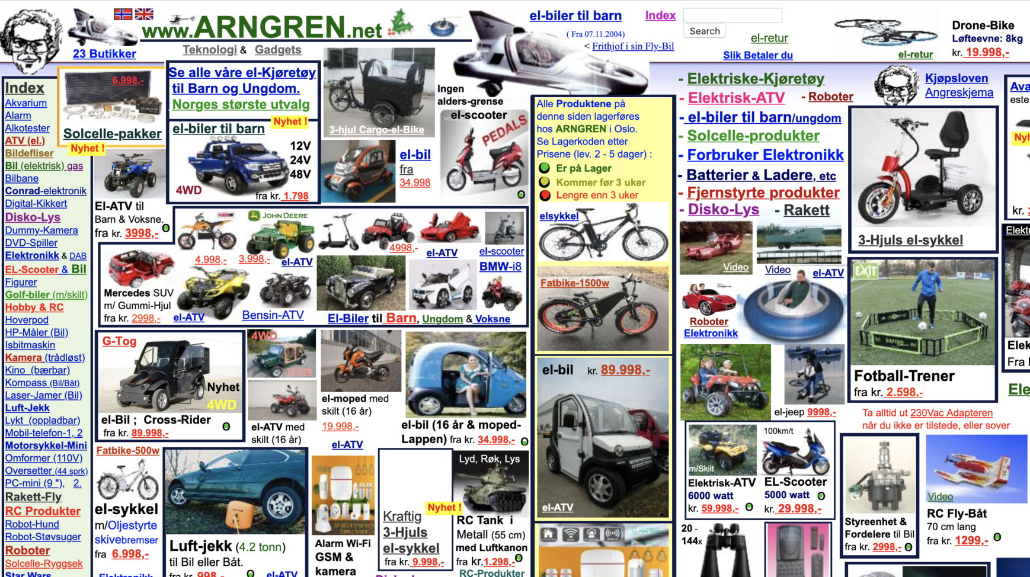
Max Information Bad Design

Slide 14
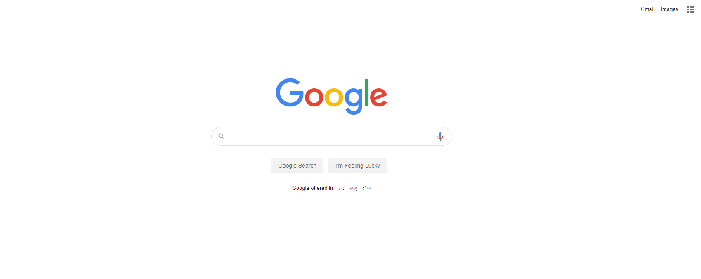
Less Information Good Design

Slide 15

Less Information Good Design

Slide 16

Find Lion?
Not me!!! Find LION… ☺

Slide 17

Cognition in Testing
Cognitive QA connects quality to desired business outcomes; minimizing risk and rapidly delivering high quality software and products to market with optimal cost savings for an enhanced customer experience and a stronger brand reputation

Slide 18
Quality VS Testing
Key Aspects of Quality:
Good design – looks and style
Good functionality – it does the job well
Reliable – acceptable level of breakdowns or failure
Consistent
Durable – lasts as long as it should
Good after sales service
Value for money

Slide 19
Quality VS Testing
? GOOD QUALITY
MERCEDES-BENZ OR SUZUKI MEHRAN

Slide 20
Quality VS Testing
Two Views of Quality Definition
Popular View: Quality is directly related to CLASS.
Technical View: To meets Customer Level of Satisfaction within Time Budget and Scope.

Slide 21
Quality VS Testing
“TESTING is the measurement of QUALITY”

Slide 22
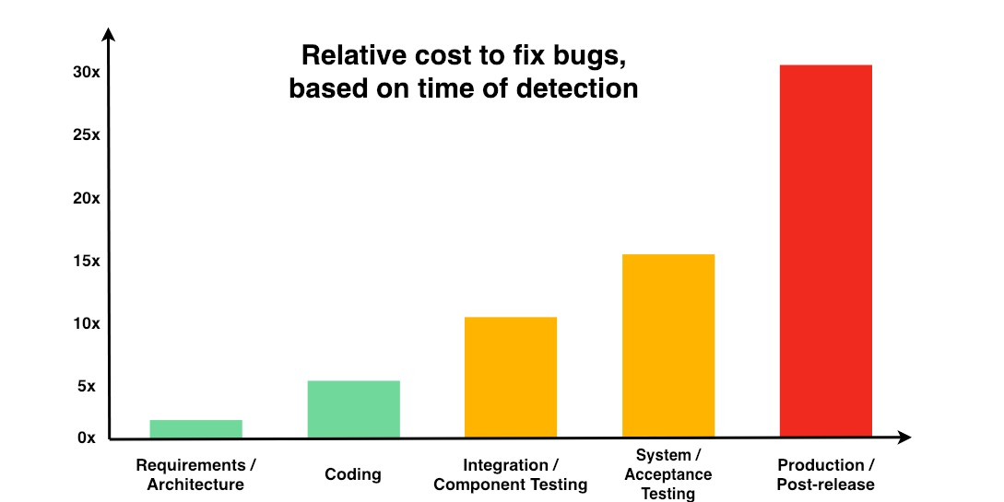
Cost of Defect

Slide 23
General Testing Terms
?
Bug
Defect
Error
Mistake
Fault
Failure

Slide 24
General Testing Terms
“A human being can make an error (mistake), which produces a defect(fault, bug) in the program, code or in a document. If a defect in code is executed, the system may fail to do what is should do (or do something it shouldn’t), causing a failure.”
Defects in software, systems or documents may result in failures, but not all defects do so.

Slide 25
General Testing Principle
Testing shows the presence of defects, not their absence
Exhaustive testing is impossible
Early testing saves time and money
Defects cluster together
Beware of the pesticide paradox
Testing is context dependent
Absence-of-errors is a fallacy

Slide 26
Seven Testing Principles
Numbers of testing principles have been suggested over the past 50 years and offer general guidelines common for all testing.
1. Testing shows the presence of defects, not their absence: Testing can show that defects are present but cannot prove that there are no defects. Testing reduces the probability of undiscovered defects remaining in the software but, even if no defects are found, testing is not a proof of correctness.
2. Exhaustive testing is impossible Testing everything (all combinations of inputs and preconditions) is not feasible except for trivial cases. Rather than attempting to test exhaustively, risk analysis, test techniques, and priorities should be used to focus test efforts.
3. Early testing saves time and money To find defects early, both static and dynamic test activities should be started as early as possible in the software development lifecycle. Early testing is sometimes referred to as shift left. Testing early in the software development lifecycle helps reduce or eliminate costly changes.

Slide 27
Seven Testing Principles
4. Defects cluster together A small number of modules usually contains most of the defects discovered during pre-release testing or is responsible for most of the operational failures. Predicted defect clusters, and the actual observed defect clusters in test or operation, are an important input into a risk analysis used to focus the test effort (as mentioned in principle 2).
5. Beware of the pesticide paradox If the same tests are repeated over and over again, eventually these tests no longer find any new defects. To detect new defects, existing tests and test data may need changing, and new tests may need to be written. (Tests are no longer effective at finding defects, just as pesticides are no longer effective at killing insects after a while.) In some cases, such as automated regression testing, the pesticide paradox has a beneficial outcome, which is the relatively low number of regression defects.

Slide 28
Testing Objectives
To evaluate work products such as requirements, user stories, design, and code.
To verify whether all specified requirements have been fulfilled.
To validate whether the test object is completed and works as the users/stakeholders expect.
To build confidence in the level of quality of the test object.
To prevent defects.
To find failures and defects.
To reduce the level of risk of inadequate software quality (undetected failures in operation).
To comply with contractual, legal, or regulatory requirements or standards.
To provide sufficient information to stakeholders to allow them to make informed decisions, especially regarding the level of quality of the test object.

Slide 29
Testing Vocabs
Test Process: The set of interrelated activities comprising of test planning, test monitoring and control, test analysis, test design, test implementation, test execution, and test completion.
Test Policy: A high-level document describing the principles, approach and major objectives of the organization regarding testing.
Test Strategy: Documentation that expresses the generic requirements for testing one or more projects, providing detail on how testing is to be performed, and is aligned with the test policy.
Test Approach: The implementation of the test strategy for a specific project.
Test Plan: Documentation describing the test objectives to be achieved and the means and the schedule for achieving them, organized to coordinate testing activities.
Test Estimation: The calculated approximation of a result related to various aspects of testing (e.g., effort spent, completion date, costs involved, number of test cases, etc.).

Slide 30
Testing Vocabs
Test Design: The activity of deriving and specifying test cases from test conditions.
Test Basis: The body of knowledge used as the basis for test analysis and design.
Test Condition: A feature, piece of functionality, or anything that you intend to verify.
Test Analysis: The activity that identifies test conditions by analyzing the test basis.
Test Cases: A set of preconditions, inputs, actions, expected results and postconditions, based on test conditions.
Test Script: A sequence of instructions for the execution of a test (Automated Code).
Test Procedure: A sequence of test cases in execution order, and any associated actions that may be required to set up the initial preconditions and any wrap up activities post execution.
Test Suite: A set of test cases or test procedures to be executed in a specific test cycle.
Test Data: Data created or selected to satisfy the execution preconditions and inputs to execute one or more test cases.

Slide 31
Testing Vocabs
Test Object: The component or system to be tested.
Test Item: A part of a test object used in the test process.
Test Objective: A reason or purpose for designing and executing a test.
Test Oracle: A source to determine expected results to compare with the actual result of the system under test.
Test Automation: The use of software/script to perform or support test activities.
Test Environment: An environment containing hardware, instrumentation, simulators, software tools, and other support elements needed to conduct a test.

Slide 32
Testing Vocabs
Testware: Work products produced during the test process for use.
Test Input: The data received from an external source by the test object during test execution. The external source can be hardware, software or human.
Test Implementation: The activity that prepares the testware for test execution based on test analysis and design.
Test Execution: The process of running a test on the component or system under test, producing actual result(s).
Test Harness: A test environment comprised of stubs and drivers needed to execute a test.
Test Progress Report: A test report produced at regular intervals about the progress of test activities against a baseline, risks, and alternatives requiring a decision. and/or times, and interdependencies.
Test Summary Report: A test report that provides an evaluation of the corresponding test items against exit criteria.

Slide 33
Testing Vocabs
Test Oracle
Test Basis → Test Condition → Test Case → Test Procedure → Test Implement → Test Execution →
Test Progress Report → Test Summary Report
Test Analysis Test Design
Test SUITE = Test Procedure + Test Case

Slide 34
Test Process
A test process consists of the following main groups of activities:
Test Planning
Test Monitoring and Control
Test Analysis
Test Design
Test Implementation
Test Execution
Test Completion
Group → Activities → Sub Activities → Tasks (which would vary from one project or release to another)

Slide 35
Test Process
Test Planning:
To determine the scope and risks.
To Identify the objectives of testing.
To determine the test approach.
To implement the test policy and/or the test strategy.
To determine the required test resources like people, test environments, PCs, etc.
To schedule test analysis, test design, test implementation, execution & evaluation.
To determine the Entry and Exit criteria
ARTIFACT | WORK PRODUCT: TEST PLAN DOCUMENT

Slide 36
Test Process
Test Monitoring and Control:
Test monitoring involves the on-going comparison of actual progress against the test plan.
Test control involves taking actions necessary to meet the objectives of the test plan.
Test monitoring and control are supported by the evaluation of exit criteria.
Checking test results and logs against specified coverage criteria
Assessing the level of component or system quality based on test results and logs
Determining if more tests are needed.
Test progress against the plan is communicated to stakeholders in test progress reports, including deviations from the plan and information to support any decision to stop testing.

Slide 37
Test Process
Test Analysis:
Determines “what to test”.
Analyze Test Basis to defining and prioritizing test conditions for each feature considering functional, non-functional, and structural characteristics, other business and technical factors, and levels of risks
Identifying features and sets of features to be tested
Capturing traceability between test basis and the associated test conditions
Test analysis may also result in the discovery and reporting of defects in the test basis.

Slide 38
Test Process
Test Design:
Test design answers the question “how to test?”
Test conditions are elaborated into high-level test cases, sets of high-level test cases, and other Testware.
Designing and prioritizing test cases and sets of test cases
Identifying necessary test data to support test conditions and test cases
Designing the test environment and identifying any required infrastructure and tools
Capturing bi-directional traceability between the test basis, test conditions, test cases.

Slide 39
Test Process
Test Implementation:
Answers the question “do we now have everything in place to run the tests?”
Implementation of testware necessary for test execution.
Implementation of Test Procedures and Test Suites.
Creation of automated Test Scripts.
Prioritize and Schedule Test Suite for Test execution.
Setup the test environment and verifying that required things has been set up correctly.
Preparing test data and ensuring it is properly loaded in the test environment.
Verifying and updating traceability between the test basis, test conditions, test cases, test procedures, and test suites.

Slide 40
Test Process
Test Execution
Test suites are run in accordance with the test execution schedule.
Recording the IDs and versions of the test item(s) or test object, test tool(s), and testware.
Executing tests either manually or by using test execution tools
Comparing actual results with expected results
Analyzing anomalies to establish their likely causes.
Reporting defects based on the failures observed.
Logging the outcome of test execution (e.g., pass, fail, blocked).
Re-execute test activities (Confirmation Testing, and/or Regression Testing).

Slide 41
Test Process
Test Completion:
Test completion activities collect data from completed test activities.
Test completion activities occur at project milestones.
Checking whether all defect reports are closed.
Creating a Test Summary Report to be communicated to stakeholders.
Finalizing and archiving the test environment, the test data, the test infrastructure for later reuse.
Handing over the testware to the maintenance teams, other project teams, and/or other stakeholders who could benefit from its use
Analyzing lessons learned from the completed test activities to determine changes needed for future iterations, releases, and projects
Using the information gathered to improve test process maturity

Slide 42
Cost of Quality
Cost of Conformance
(Good Quality)
Appraisal Cost
(assess a quality product)
Cost of Non Conformance
(Bad Quality)
Internal Failure Cost
(failure found by the project)
External Failure Cost
(failure found by customer)
Training QC staff
Document the process
Testing Equipment
Time required to do it right
Running the Test
Destructive Testing Loss
Inspecting Deliverables
Rework
Scrap
Liabilities, Law Suites, Product recalls
Warranty Work
Lost Business or Credibility
Prevention Cost
(build a quality product)
Money spent during the project
to avoid failures
Prevention Cost
(build a quality product)
Appraisal Cost
(assess a quality product)
Money spent during and after the project because of failures

Slide 43
Any Question?
End!

